Slide 1
A.I Assignment 1 (Solving the Sudoku) 2015147533 유현석
Simple explanation about whole code
1. Checking the given number and I will not use those in each row, col, square
2. With using infinite loop for checking the possible count and putting the number of minimum count
3. If I put the number then erasing and find new minimum count. When erasing all blank exit the loop

Slide 2
1. First step before solving Sudoku : (Getting the data from given number)
'''#Checking the first given number and if there is given number putting each part of
row, col, square. Then we will not use that number to each part when we find out the
number. Further more we will make array of blank pos. Each array will have
information of xpos and ypos'''
for r in range(1,10):
for c in range(1,10):
if self.given_number[r-1][c-1] ==0: # If it is blank!!
self.zero_xy.append((r-1,c-1)) # Put into array of xpos, ypos
zero_cnt +=1 # Increase number of blank
else:
self.row_check[r-1][self.puzzle[r-1][c-1]]=1 # Will not use in row
self.col_check[c-1][self.puzzle[r-1][c-1]]=1 # Will not use in col
self.square_check[self.square_num[r-1][c-1]][self.puzzle[r-1][c-1]]=1 # Will not use in square

Slide 3
2. Second step to solving Sudoku : (Check the possible count in infinite Loop)
'''#Start of infinite Loop. In this loop we will check the count of possible number of each blank. Putting the number of minimum count and check the answer. If only one number is possible, putting that number But there is no only one possible the try to find 2 or 3,4 ...... and check again 1.’‘’
while True: #Start of infinite loop
for zi in range(0, zero_cnt):
r,c =self.zero_xy[zi]
for num in range(1,10):
if self.row_check[r][num] == 0 and self.col_check[c][num] == 0 and self.square_check[self.square_num[r][c]][num]== 0:
cannum=cannum+1 # Check the count of possible number
if(Count ==1): # If there is count 1 put and will erase
if(Count can't 1 the count==2): # There is no 1 but have 2 do same work
:
if(Count can't 1,2...8 the count==9): # There is no 1,2….8 but have 9 do same work

Slide 4
3. Third step finishing solving Sudoku : (erasing the blank data, ending the loop )
'‘’#When we choose minimum count of blank and will put into case range of 1~9count. Then
we will try that counts to find the answer. After finding we will delete data and decrease the
number of blank. When number of blank becomes 0, ends the loop '‘’
Case(if count is in 1~9):
for num in range(1,10):
if self.row_check[r][num] == 0 and self.col_check[c][num] == 0 and self.square_check[self.square_num[r][c]][num]== 0:
output = self.problem.checker(r+1,c+1,num) # try to find the answer
if output ==1: # when find the answer
del self.zero_xy[zi] // zero_cnt= zero_cnt-1 #delete data and decrease the number of blank
self.puzzle[r][c]=num
self.row_check[r][num] = self.col_check[c][num= self.square_check[self.square_num[r][c]][num] = 1 # update the sudoku
break
if((zi+1)==zero_cnt or zi == zero_cnt):
zi=0 // break # There are no more blank with now counts start the loop again to find another count
if(eraze==zero_cnt):
break # Put all blank end whole loop

Slide 5
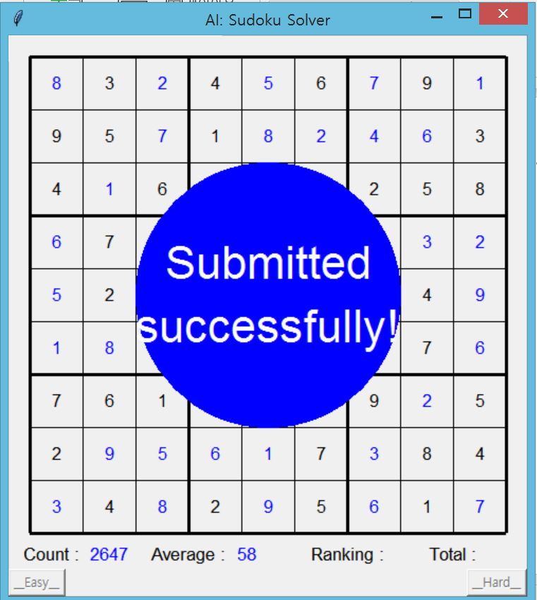
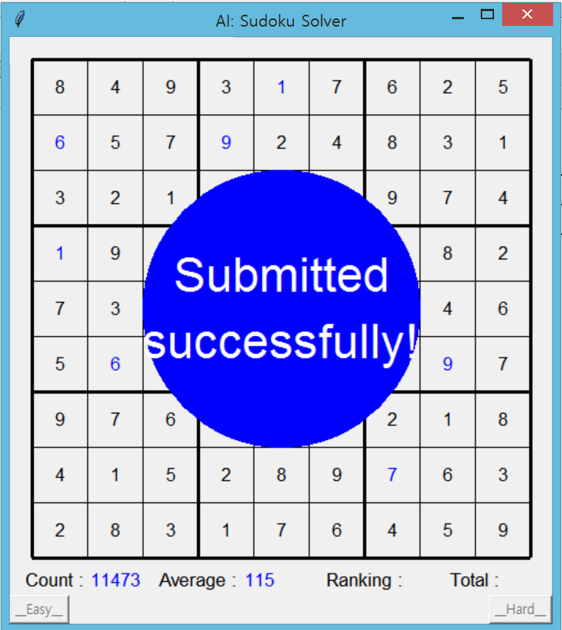
Screenshots of best scores in both setting
(easy) (hard)

